Slide 1
SECURE DATA HIDING IN IMAGES USING STEGANOGRAPHY
CAPSTONE PROJECT
Presented By: Rajkamal Sahu
College Name & Department : Shaheed Nandkumar Patel University

Slide 2
OUTLINE
Problem Statement
Technology used
Wow factor
End users
Result
Conclusion
Git-hub Link
Future scope

Slide 3
Problem Statement
With the increase in digital communication, securing sensitive information or data shared through internet has become crucial. Traditional encryption methods make it obvious that data is hidden, attracting attackers. This project leverages steganography to hide secret messages within images, ensuring covert communication.

Slide 4
Technology used
•Programming Language: Python •Libraries: OpenCV, OS •Platform: Windows 10
•Software: IDLE, CMD prompt

Slide 5
Wow factors
•Enhanced Security: Uses password-protected decryption. •Undetectable Communication: The hidden message remains invisible to the human eye. •Lightweight & Fast: Simple implementation with minimal computational overhead. •Customizable: Can be expanded to support different file formats and stronger encryption.

Slide 6
End users
•Cybersecurity researchers. •Journalists & whistle-blowers. •Intelligence agencies. •Anyone needing secure data transmission.

Slide 7
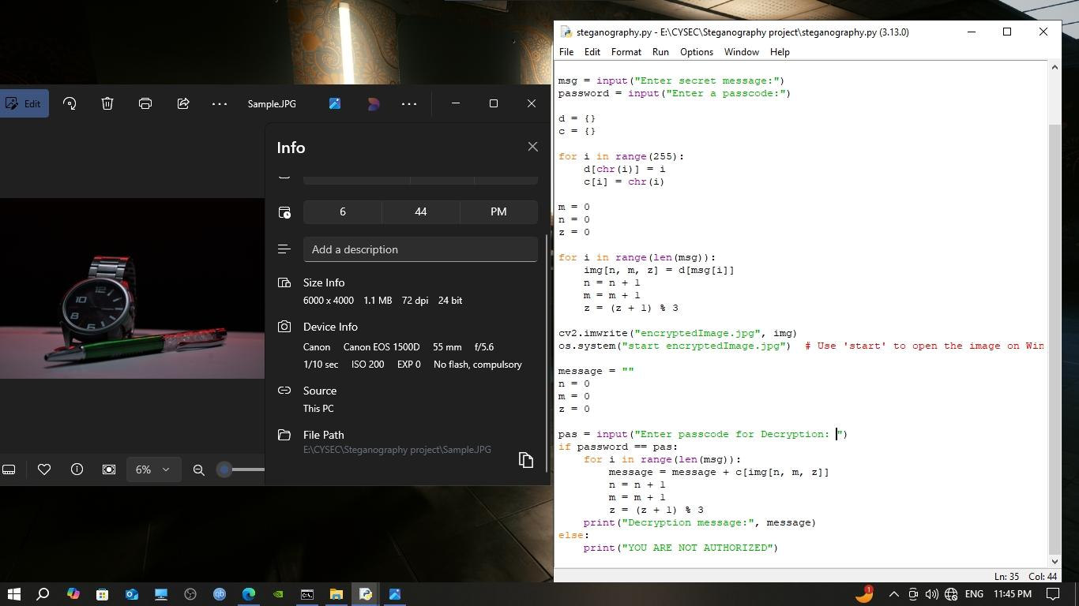
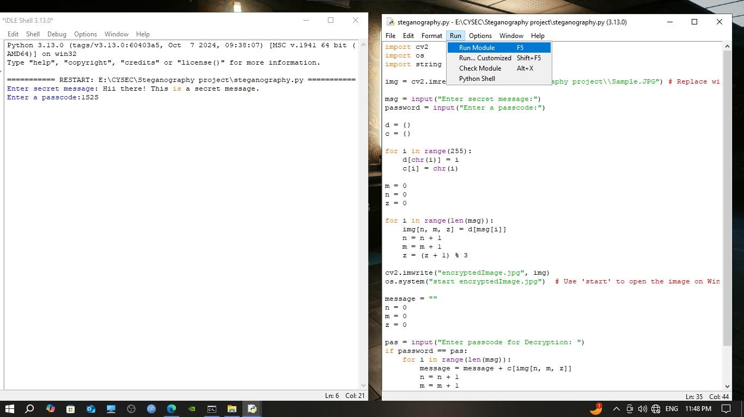
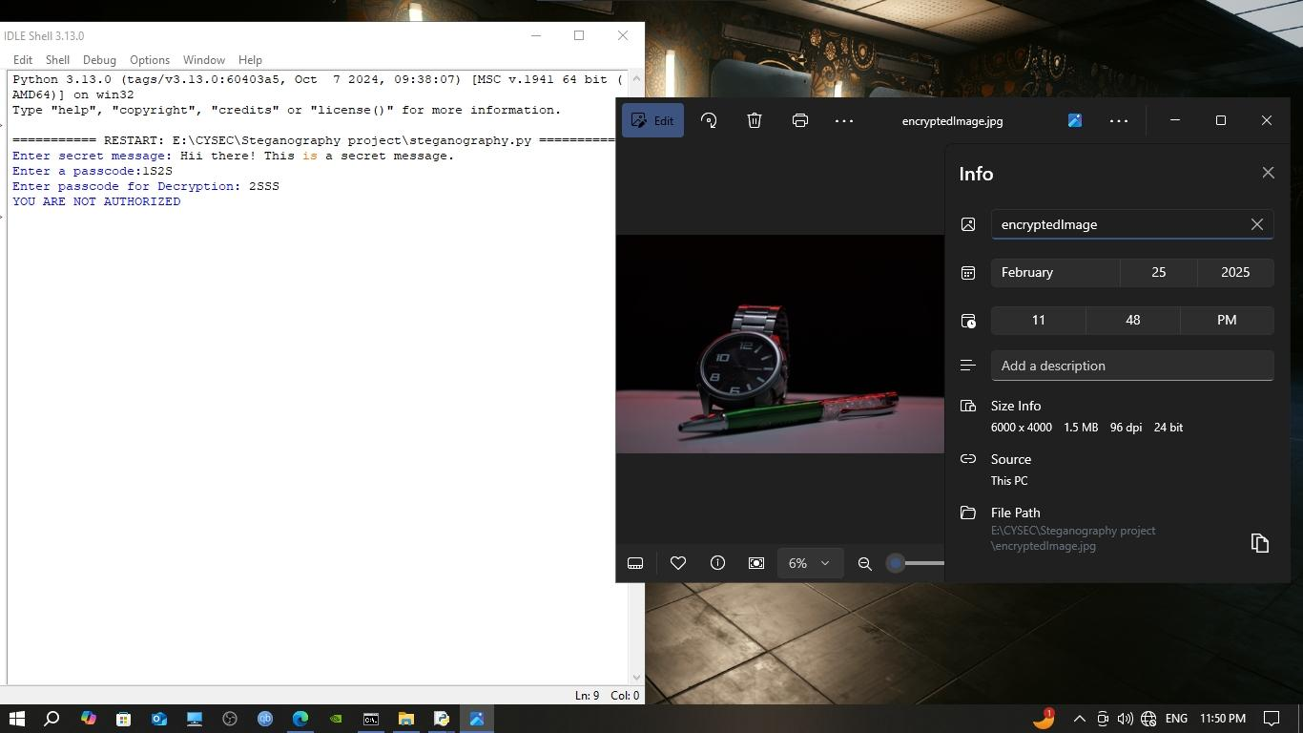
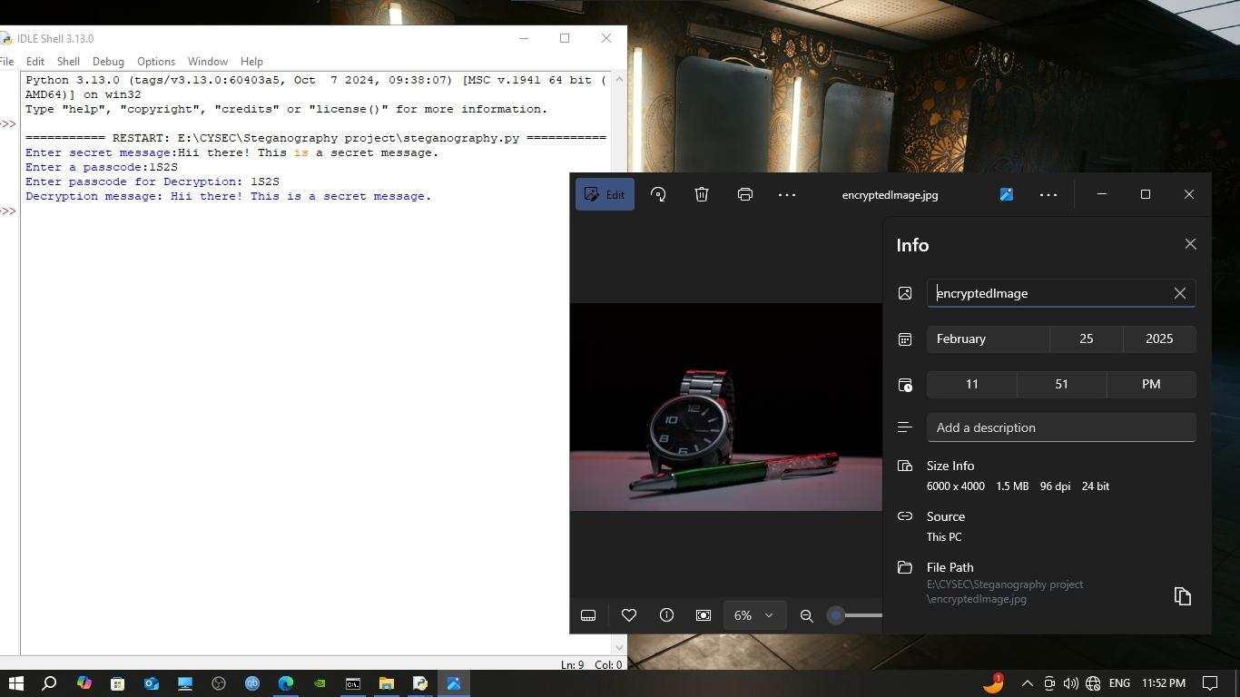
Results
.

Slide 8
Conclusion
This project successfully demonstrates how steganography can be used for secure communication by embedding a hidden message within an image. The method ensures secrecy while maintaining the original image quality.

Slide 9
GitHub Link
https://github.com/Raazsh/Steganography-Project.git

Slide 10
Future scope(optional)
•Improved security: Integrate advanced encryption before embedding the message. •Support for multiple file types: Extend beyond images to video and audio. •Machine learning integration: Detect and prevent unauthorized steganography use.

Slide 11
THANK YOU

